Slide 1
R packages and RMIS data
Kristopher Warner- WDFW
PNAMP fish monitoring workgroup

Slide 2
Outline
RMIS data overview
Workflow/limitations through the UI
Advantages of an API
Historic workarounds
Packages in development- rmisr and rrmis
Example use- rmisr
Closing thoughts

Slide 3
RMIS data overview
Pacific states marine fisheries commission’s centralized database for multi-agency records on fish releases (both hatchery and wild-tagged) and recoveries
In hatcheries, largely serves as a centralized database for retrieving production/recovery records

Slide 4
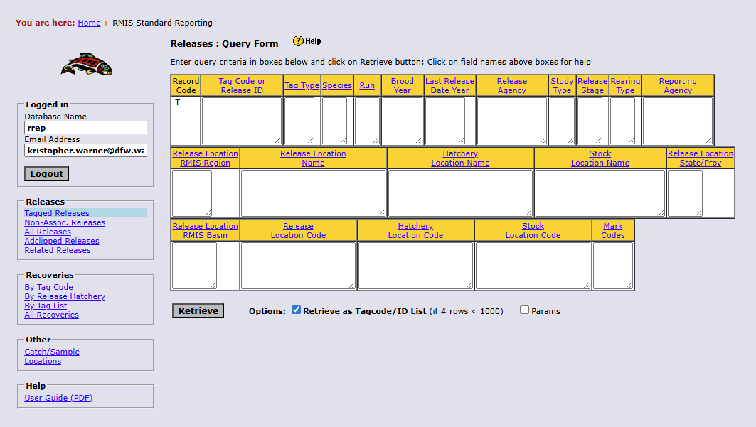
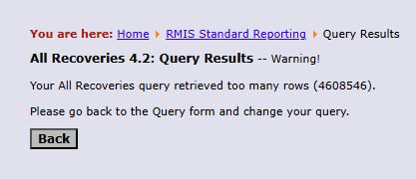
GUI workflows
RMIS gui allows for retrieving data in a variety of formats, most often in .csv
Pros- relatively intuitive, buttons are fun to press, robust for small data sets
Cons- limited by size of query, difficult to reproduce, prone to mechanical error, management of csv files can be onerous

Slide 5

API access and R
Pros- can handle much larger queries, can be scripted using R, queries are easy to share/replicate
API in early development, missing fields, larger barrier to entry for data retrieval
RMIS’ data structure has useful data stored in disparate tables

Slide 6

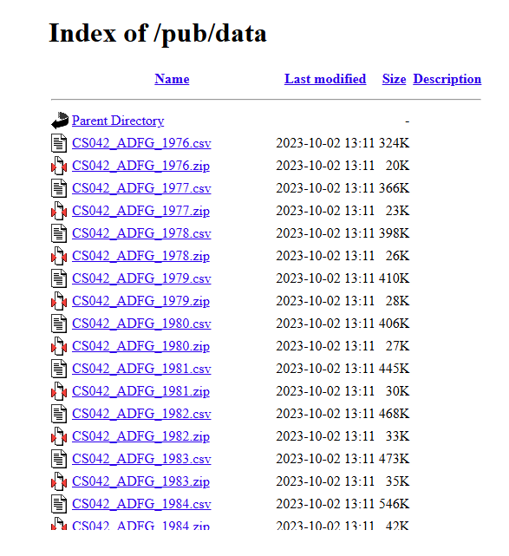
Historic workarounds
Elegant, but “brute-force”
Mirrored databases, index fetching
Allowed for scripted workflows, but memory intensive and required secondary stewarding

Slide 7
Packages in development- rmisr and rrmis
rmisr | rrmis
Retrieval directly from api | Fetches from data index
Light on memory, heavy on processing | Heavy on memory, optimized processing
Requires stable connection | Requires stable connection
Lacks QoL helper functions | Has helper functions

Slide 8
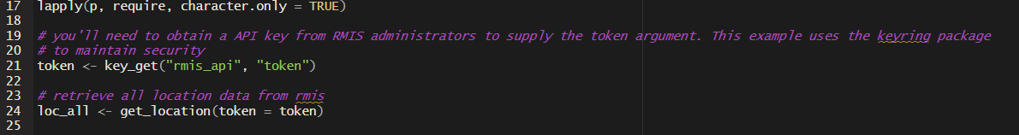

Example walkthrough- rmisr
Load necessary packages, reference your API-key, and run a retrieval function- I start with locations

Slide 9
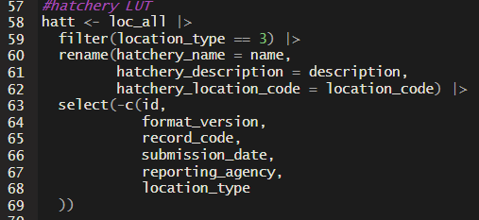

Example walkthrough-cont’d
Location data can function as a start for informed queries
  All of the “location_type”s
We can use the location data as lookup tables- in this snippet it’s hatchery locations (location type 3)

Slide 10
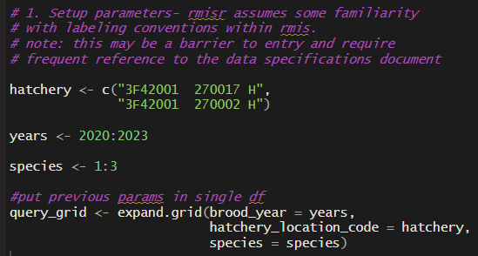
Example walkthrough-parameters
Location data can function as a start for informed queries
  All of the “location_type”s
Set up loops to query in series to handle larger datasets

Slide 11
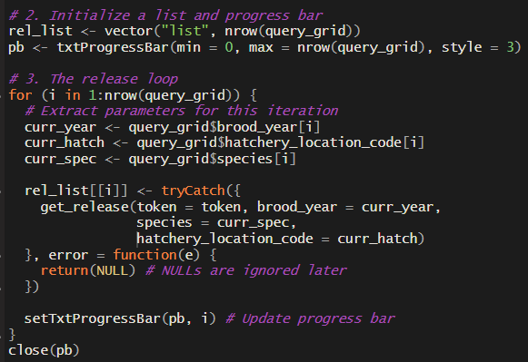
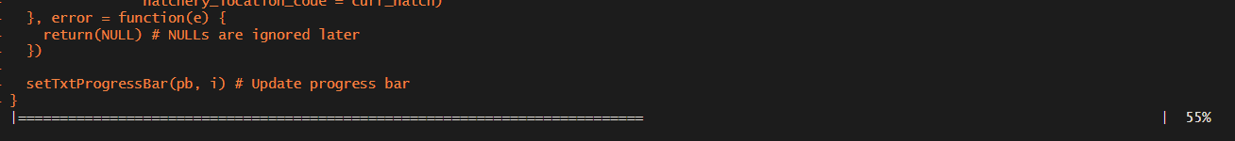
Example walkthrough-data-get loop
Parameters on previous slide are passed in a loop of the get_release() function
Loops allow us to query larger data sets

Slide 12
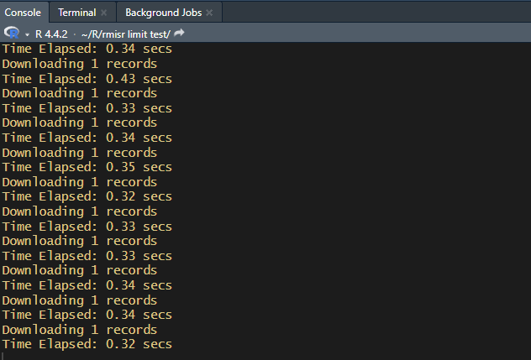
Example walkthrough-cont’d
Loops will iterate based on the number of permutations of the inputs
  Can be time intensive if there’s too many permutations
  Opportunity for optimization here, using common fields to cut down on the number of iterations

Slide 13
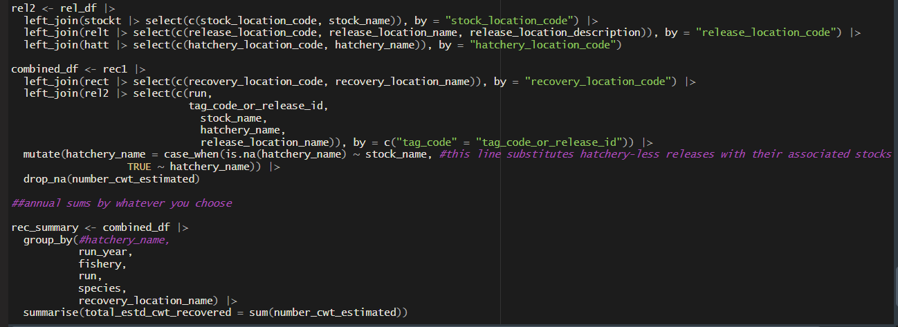
Example walkthrough- cont’d, cleanup
No helper functions currently part of the package, requires manual cleanup to get to a cohesive dataset

Slide 14
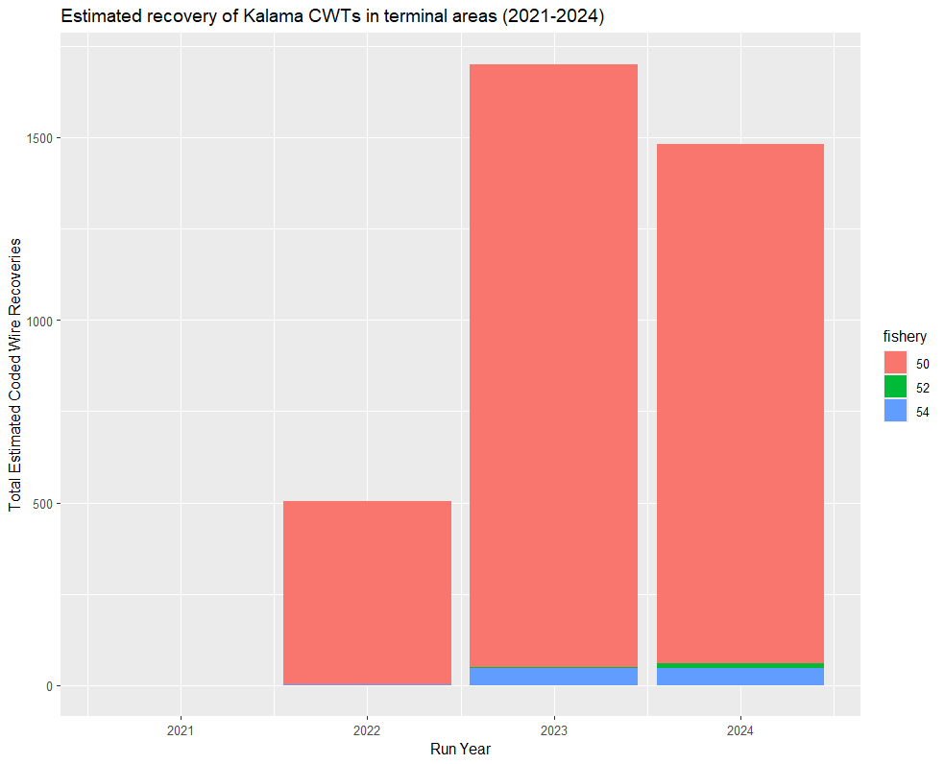
Summarize/visualize the result
We can now use graphics packages (ggplot, plotly, etc) to visualize the result

Slide 15
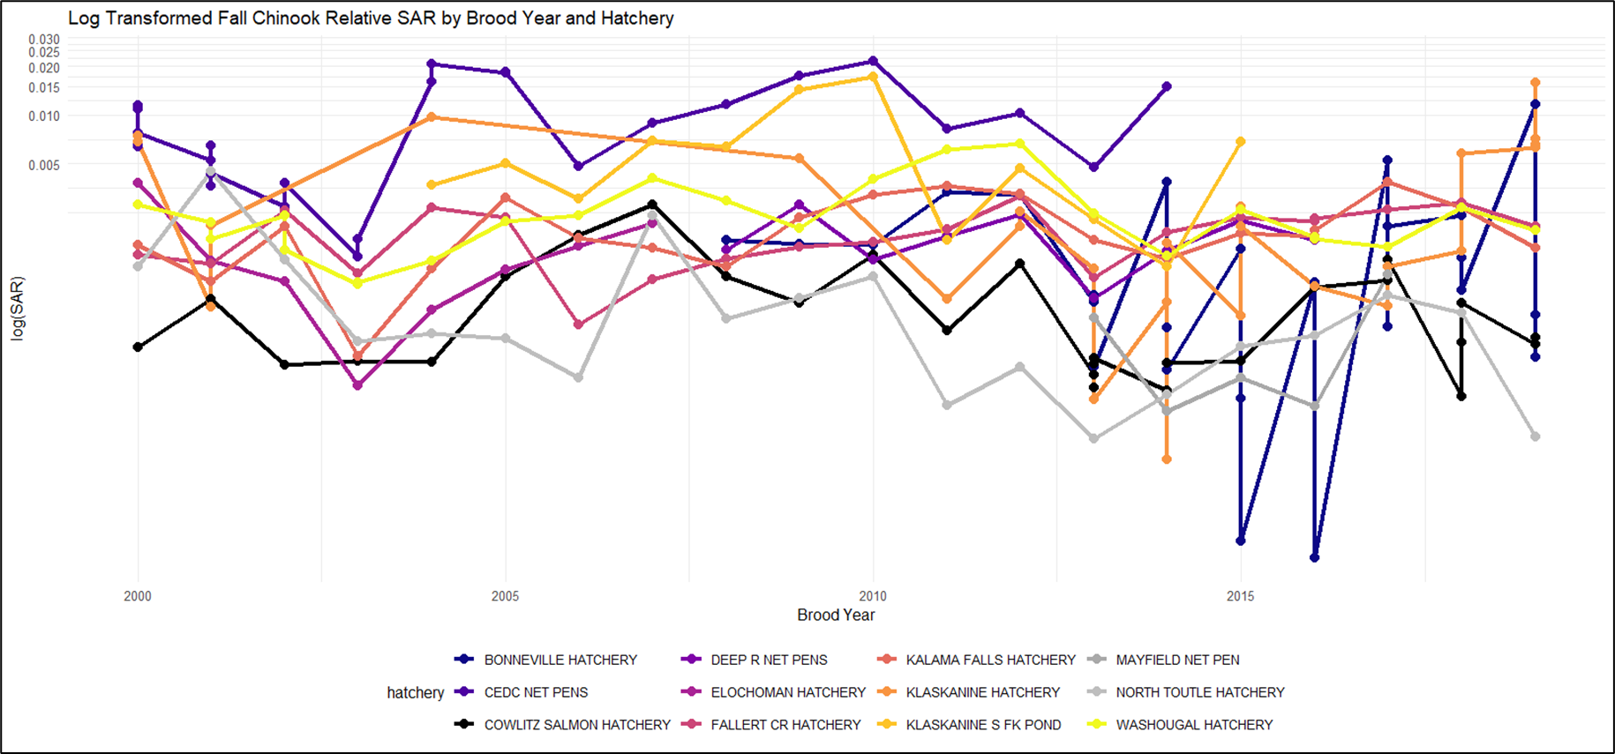
Application- comparative hatchery performance

Slide 16
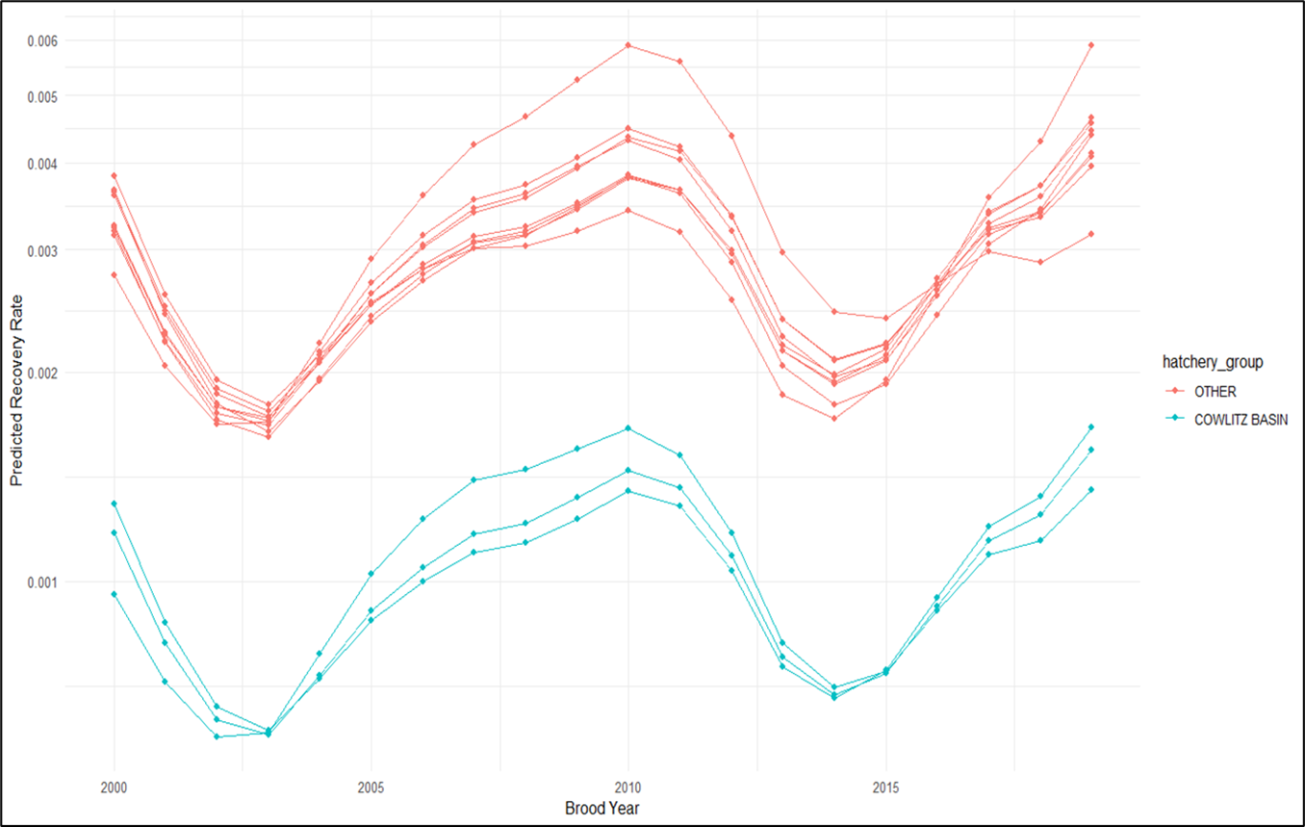
Application- comparative hatchery performance

Slide 17

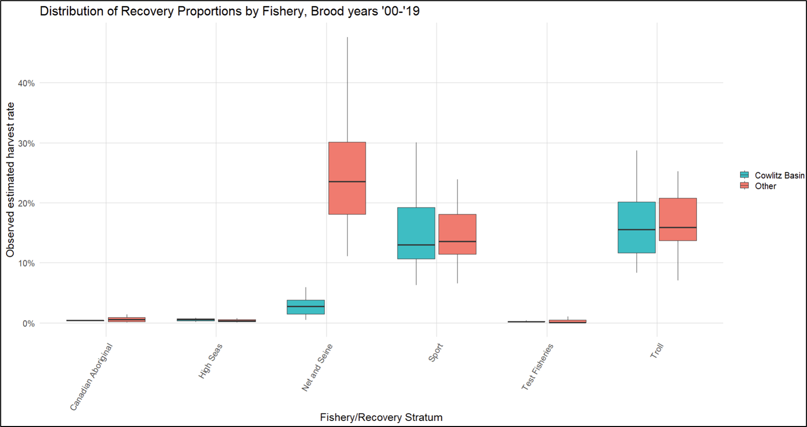
Application- comparative hatchery performance

Slide 18
Questions/resources
RMIS Data Specification document:
  Specification-V4.2-2023-12.pdf
Link to script shown in presentation:
  KJPWarner/pnamp_rmisr_presentation

